Slide 1



Blood Bank Management System
UNDER THE GUIDANCE OF: [FACULTY NAME]
PRESENTED BY:
A. NIKHITHA
B. LAKSHMI
B. KAVYA
B. LAKSHMI PRASANNA
GEETHA REDDY

Slide 2

Introduction
▶ Blood Bank Management System ensures safe storage,
tracking, and distribution of blood.
▶ It connects hospitals, donors, and patients seamlessly,
making life-saving blood accessible at the right time.

Slide 3








emergencies.
Growing medical
Shortage of specific blood types.
Why is it Needed?
Need for quick and reliable access.
Streamlining donor- recipient matching.

Slide 4





Objectives
Efficient donor and recipient information management.
Quick blood stock
tracking.
Minimize wastage
and shortage.
Promote voluntary
blood donation.
Ensure easy access during emergencies.

Slide 5

System Modules
▶ Donor Registration Module
▶ Blood Inventory Management
▶ Request Processing Module
▶ Notification and Alerts System
▶ Admin Dashboard

Slide 6





Key Features
Real-time blood stock monitoring.
Blood group and location-based search.
SMS/email notifications for blood requests.
Secure database and user authentication.
Reports and analytics for administrators.

Slide 7

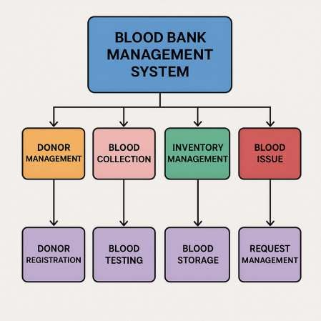

Slide 8



▶Step 1: Start
▶Step 2: Define the Donor structure
▶Fields:
▶name (string)
▶bloodGroup (string)
▶location (string)
▶next (pointer to next Donor)
▶Step 3: Initialize
▶head = NULL (start of linked list)
ALGORITHM
▶Step 4: Load Donors from File
▶Open the file donors.txt in read mode.
▶For each record:
▶Read name, bloodGroup, and location.
▶Create a donor node and insert it into the linked list.
▶Close the file.
▶Step 5: Show Menu (Repeat Until User Exits)
▶pgsql
▶1. Add Donor 2. Display All Donors 3. Search Donor by Blood
Group and Location 4. Exit

Slide 9
Step 6: If user selects "Add Donor"
Input name, bloodGroup, and location.
Create a new donor node.
Insert the node at the end of the linked list.
Save all donors to donors.txt.
Step 7: If user selects "Display All Donors"
Traverse the linked list from head.
Print each donor’s details.
Step 8: If user selects "Search Donor"
Input search bloodGroup and location.
Traverse the linked list.
Step 9: If user selects "Exit"
Save all donor data to donors.txt.
Exit the program.

Slide 10


Challenges Faced
▶ Maintaining up-to-date donor
information.
▶ Managing rare blood groups.
▶ Ensuring system security and data privacy.
▶ Encouraging regular
voluntary donations.

Slide 11

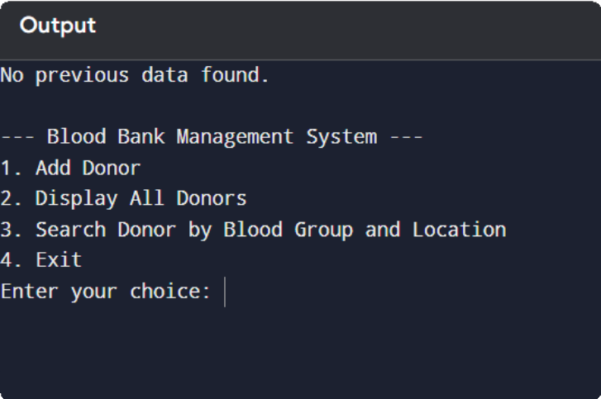
SOURCE CODE&OUTPUT
▶ SOURCE CODE

Slide 12


▶ A Blood Bank Management System plays a crucial role in healthcare by ensuring quick, secure, and efficient management of blood resources, ultimately saving countless lives.
Conclusion

Slide 13


REFERENCE
- FROM TEACHERS' GUIDELINES
- FROM TEXTBOOK
- FROM PREVIOUS PROJECT WORKS

Slide 14


